Slide 1


Predicting Customer Churn in Telecom Company
Subject : ALY6040 DATA MINING APPLICATIONS
INSTRUCTOR : PROFESSOR JUSTIN GROSZ
Group : Ankit Bhalekar ,Apurwa Sontakke ,Lazaree Worlikar , Vedant Wagh

Slide 2


Real world problem :Customer Churn
What is customer churn?
Customer churn is when customers stop doing business with a company, leading to revenue loss
Results:
Increased customer acquisition costs, eroded loyalty, negative word-of-mouth, reduced customer lifetime value, competitive disadvantages, and inefficient resource allocation.
To reduce churn, companies improve customer service, offer loyalty programs, enhance product quality, and collect customer feedback.

Slide 3
Data Description
Dataset: Customer Churn Prediction Dataset
Source : Kaggle
Rows: 7043
Variables: 21
Purpose: Analysis and prediction of customer churn in a telecommunications company.
Information Included:
Customer demographics
Services subscribed
Monthly charges
Churn status (whether or not a customer has churned)
Chosen this dataset to explore factors influencing customer churn and develop strategies for reducing churn in the telecommunications industry.

Slide 4

Objective
Investigate factors influencing customer attrition in a telecom company.
Develop predictive models to retain customers.
Provide recommendations based on findings.

Slide 5

Data Cleaning
No duplicates rows.
Made sure all the columns are in proper format e.g., Converted “senior citizen” from integer to category.
Handled 0.15% missing data by dropping rows.
No outliers found in the dataset.
Churn: 26.6% (1869), No Churn: 73.4% (5163)

Slide 6





Exploratory Data Analysis

Slide 7
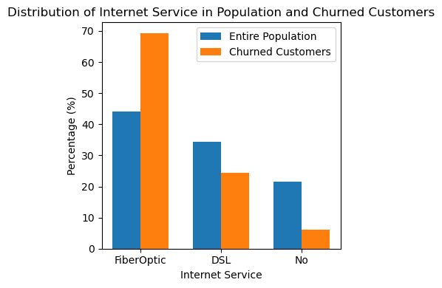
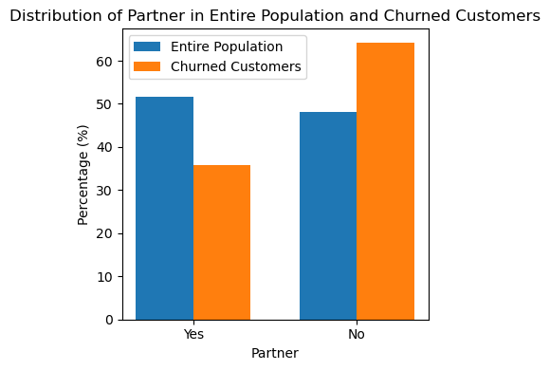
The distribution of the ‘partner’ variable appeared different between the overall population and the churn subset. A chi-square test supported our claim, establishing an association between ‘partner’ and churn.
2. Lower churn rates among customers with no internet service, and a chi-square test verified the relationship between internet service and churn Notably, the highest churn was among customers who opted for Fiber Optic, potentially indicating issues with service quality

Slide 8
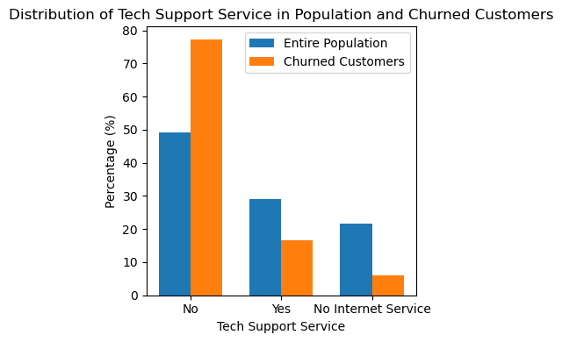
77.3% churned customers lacked tech support. Tech support linked to churn. A chi-square test confirmed the significant association between tech support and churn

Slide 9
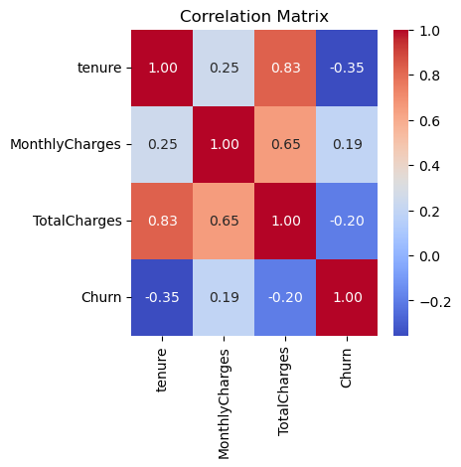
Logistic Regression
Reason for using this algorithm:
Logistic regression is well-suited for such problems as it predicts the probability of a customer belonging to one of the two classes.
Data Preparation:
Encode categorical data (one-hot).
Scale numerical data (standardize).
Correlation Analysis:
High correlation between "tenure" and "TotalCharges" (0.83).
"MonthlyCharges" and "TotalCharges" (0.65).
Decision:
Drop "TotalCharges" before modeling.

Slide 10
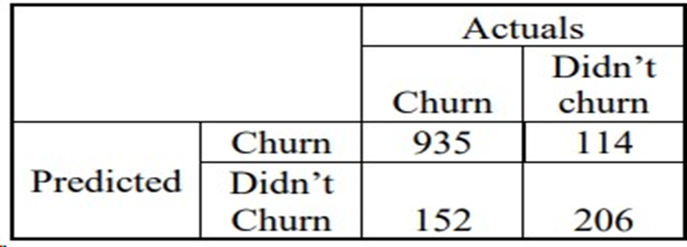
Baseline logistic regression results
Performance Metrics :
Accuracy: 81.09%,
Precision: 64.34%
Recall: 57.54%,
F1-Score: 60.76%
Emphasis on Recall:
Recall is prioritized over accuracy and precision
It helps identify potential churners effectively
Importance of Maximizing Recall:
Proactive churn prediction for revenue protection and enhanced customer retention efforts

Slide 11
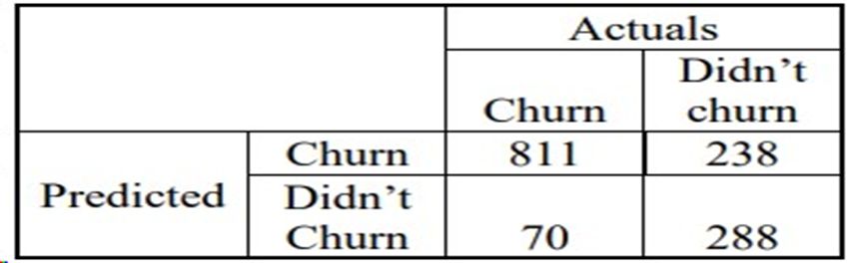
Optimized Logistic Regression
Fine-tuned the model by lowering the threshold from 0.5 to 0.3 for churning prediction.
Increased model's leniency in classifying observations as positive
Performance Metrics:
Accuracy: 78.10%
Precision: 54.75%
Recall: 80.44%
F1-Score: 65.15%
Few Significant variables:
Tenure (-0.8241): Longer tenure indicates lower churn likelihood.
Contract (Two years) (-0.568) :Longer-term contracts reduce churn compared to shorter-term or monthly contracts.
PaymentMethod_Credit card (automatic)(-0.0264): Promoting credit card payments, especially automatic ones, linked to higher customer retention

Slide 12

Decision Tree
Logistic regression assumes linear relationship between the independent variables and the log-odds of the dependent variable, we will now try using decision tree to predict whether a customer will churn or not which does not make such assumption.

Slide 13
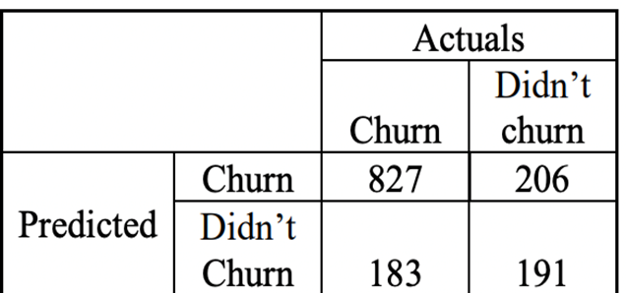
Baseline Decision Tree
Model Performance:
Accuracy: 72.3%
Precision: 48.11%
Recall: 51.06%
F1 Score: 49.54%
Observation:
The recall of 51.06% indicates the model identifies only half of the churners in the dataset. This suggests potential room for improvement.

Slide 14
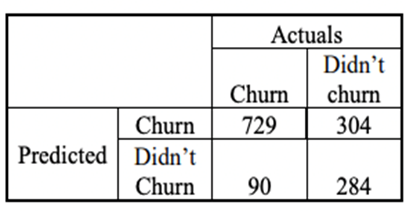
Optimized Decision Tree
Used Grid Search CV to find the best combination of hyperparameters for the Decision Tree model . The best hyperparameters were class weight: 'Balanced' , criterion: 'entropy' , max_depth: 10 , min_samples_leaf: 30 , min_samples_split: 10
◦Performance Metrics:
Accuracy: 72%
Precision: 48%
Recall: 76%
F1-Score: 59%
Feature Importance Highlights:
Contract Duration: Crucial to churn rates; longer contracts often mean less churn.
MonthlyCharges: Directly influences churn; higher charges increase churn likelihood.
Tenure: Symbolizes loyalty; extended tenure indicates less churn.

Slide 15
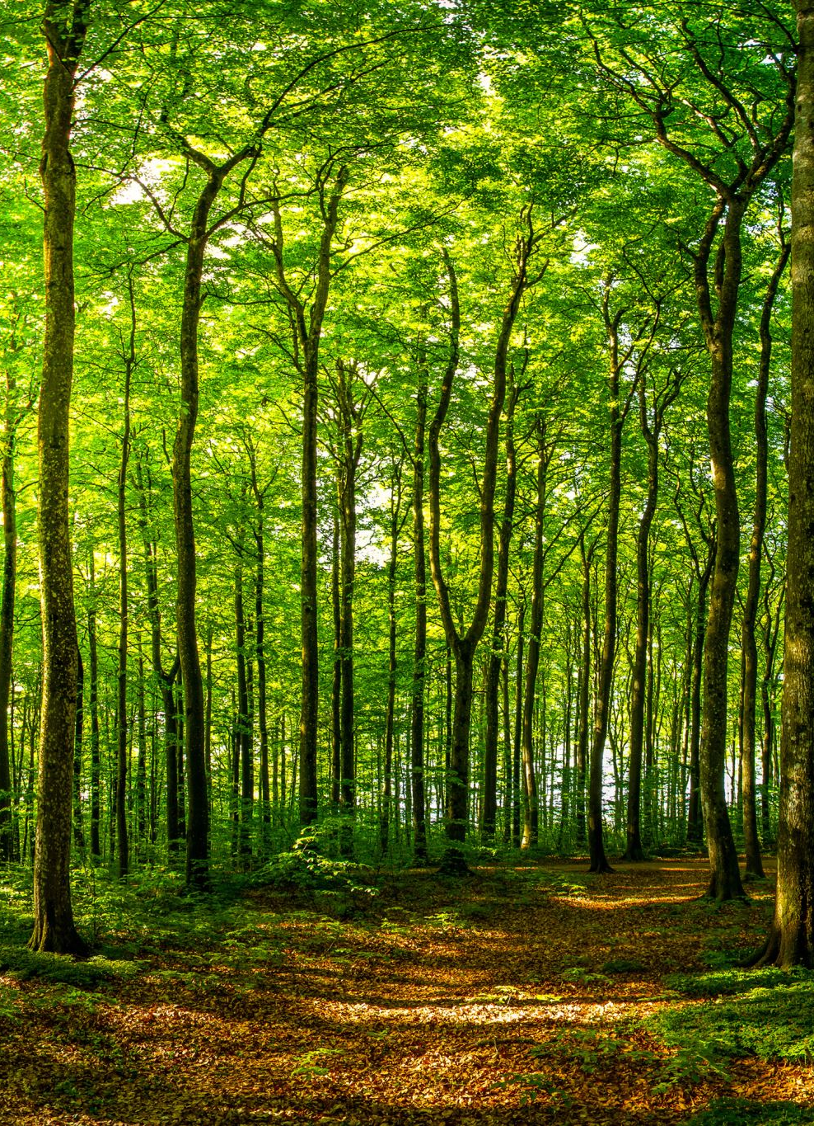
Random Forest
We will now try Random Forest because decision trees can be prone to overfitting, creating models that are overly complex and don't generalize well. Random Forest mitigates this issue by aggregating the results of multiple trees, leading to more robust models. Also, random forests are effective at capturing non-linear relationships between features and the target variable unlike logistic regression which assumes linear relationship between the independent variables and the log-odds of the dependent variable.

Slide 16
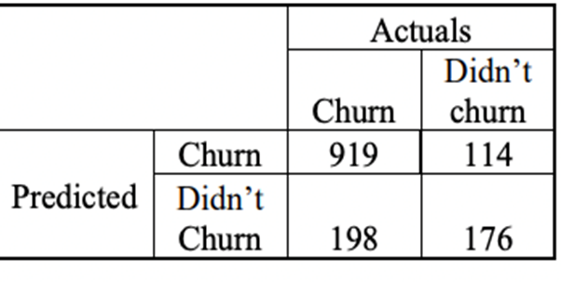
Baseline Random Forest
Performance Metrics:
Accuracy: 77.82%
Precision: 60.68%
Recall: 47%
F1-Score: 53%
Observations:
Recall is lower than desired .indicates the model identifies only 47% of the churners in the dataset. We will try to optimize this model .

Slide 17
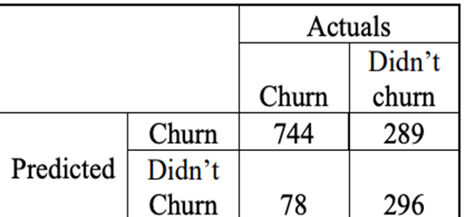
Optimized Random Forest
Used Grid Search CV to find the best combination of hyperparameters for the Random Forest model . The best hyperparameters were “class_weight”: “balanced”, “max_depth”: 20, “min_samples_leaf”: 30, “min_samples_split”: 10, “n_estimators”: 200
Performance Metrics:
Accuracy: 74%
Precision: 51%
Recall: 79%
F1-Score: 62%
Feature Importance Highlights:
Contract and Tenure: Longer contracts and tenure relate to lower churn.
OnlineSecurity and Tech Support: Access to these services reduces likelihood of churn.
MonthlyCharges and Internet Service: Higher charges and specific services (e.g., Fiber Optic) could increase churn.

Slide 18
Comparing model performances
Model | Accuracy | Precision | Recall | F1-Score
Optimized Logistic Regression | 78.10% | 54.75% | 80.44% | 65.15%
Optimized Decision Tree | 72% | 48% | 76% | 59%
Optimized Random Forest | 74% | 51% | 79% | 62%
Logistic Regression Dominance: It outperforms both Decision Tree and Random Forest in all considered metrics.
Recall as a Priority: Our primary goal is to minimize False Negatives, which means we aim to capture as many actual churners as possible. Higher recall ensures that.
Logistic Regression’s Recall: Standing at 80.44%, it significantly reduces the risk of missing potential churners, aligning with our business objective.

Slide 19
Conclusion and Recommendations
Key Insights:
Logistic regression outperformed others in predicting customer churn.
Features : High monthly charges and Fiber Optic service quality are major churn drivers.
Contract Length: Longer contracts lead to lower churn rates.
Recommendations:
Re-evaluate Pricing: Adjust monthly charges for better retention.
Enhance Services: Improve Fiber Optic internet quality and tech support.
Promote Long-Term Contracts: Encourage customers to opt for longer commitments.
Future Directions:
Analyze Customer Feedback: Utilize surveys and reviews for direct insights.
Monitor Competitor Pricing: Stay competitive and adapt to market changes.
Takeaway: Implementing the strategies can significantly reduce customer churn, leading to sustained customer relationship and business growth.

Slide 20

Acknowledgement
We would like to extend our heartfelt appreciation to Professor Justin Grosz for his exceptional guidance and mentorship throughout the course of our project. Professor Grosz’s unwavering support and expertise have been invaluable, and we are truly grateful for his dedication to our academic and professional development. We would also like to express our thanks to our dedicated classmates, whose camaraderie, collaboration, and insightful discussions have significantly enriched our educational journey. Your collective support has made this academic experience both rewarding and enjoyable. Thank you all for your contribution

Slide 21
References:
1. Koehrsen, W. (2018, January 17). Random Forest in python. Medium. https://towardsdatascience.com/random-forest-in-python-24d0893d51c0 2. Li, S. (2019, February 27).
2. Building a logistic regression in Python, step by step. Medium. https://towardsdatascience.com/building-a-logistic-regression-in-pythonstep-by-step-becd4d56c9c8

